Slide 1


Ghana Data Centre and Ghana R Users Conference
2025
Theme
Harnessing R for Sustainable Development:
Innovations collaborations and Health Impacts
Ghana R Users Community & NHR – GSU Ghana Hub Data Centre

Slide 2



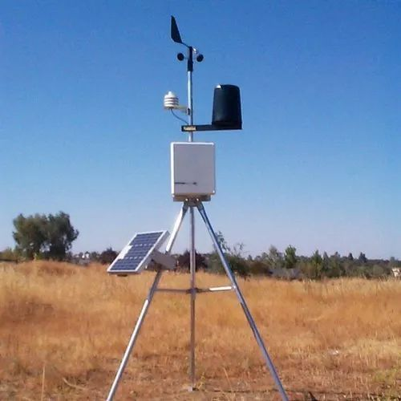

MACHINE LEARNING IN ENVIRONMENTAL MONITORING: An Perspective
Presented By
George Kyei Agyen
gkagyen@ghana-rusers.org

Slide 3
Content Outline
Part 1:
Env. modelling & Machine Learning
Overview of Environmental Monitoring
Role of Machine Learning in Env. Monitoring
Types of machine learning
Why Use R
Key Packages to Consider
Part 2:
ML Workflow Live Coding Demo
Tidymodels workflow code snippet
Live code demonstration
Useful resources

Slide 4
PART 1:
Environmental Modelling and ML Presentation

Slide 5

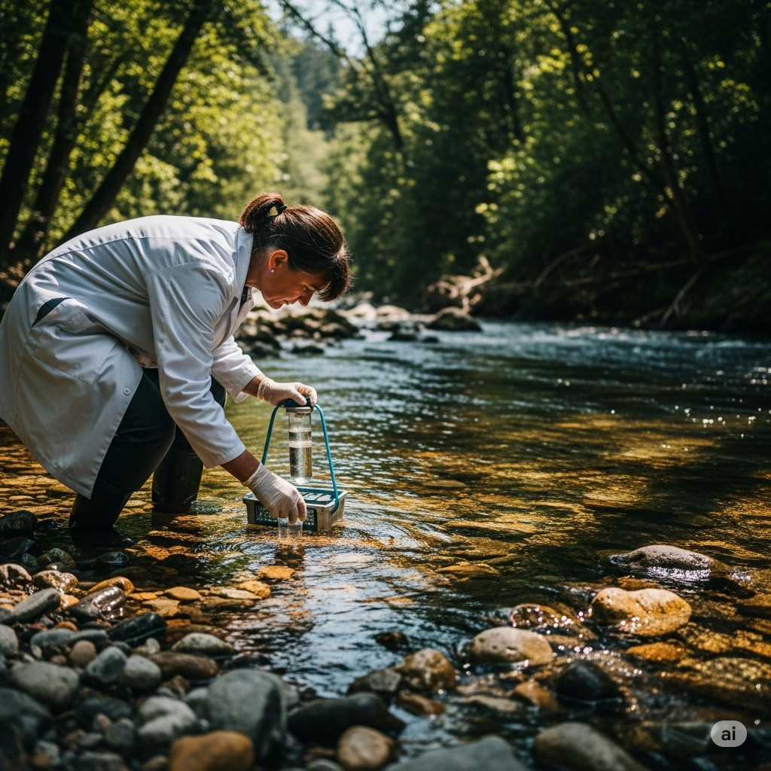
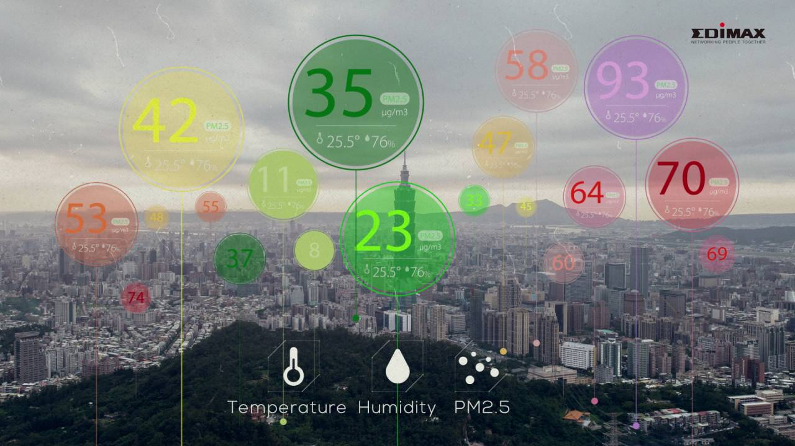
Overview of Environmental Monitoring
Environmental monitoring is the collection and analysis of data to manage natural resources sustainably
It involves monitoring air quality, water resources, soil conditions, wildlife populations, and weather patterns

Slide 6

The Role of Machine Learning
Machine Learning (ML) is a subfield of Artificial Intelligence (AI) that focuses on enabling computers to learn from data without being explicitly programmed.
Basically, ML algorithms analyse datasets to identify patterns, learn from these patterns, and then make predictions on new unseen data
This "learning" process allows systems to improve their performance over time as they are exposed to more data

Slide 7
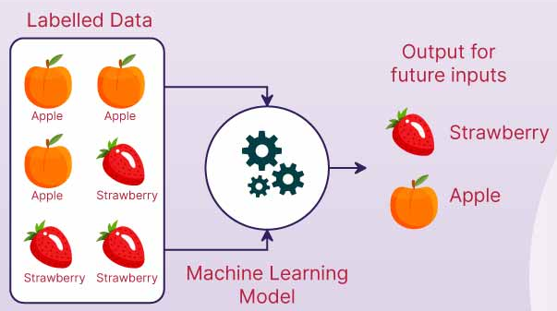
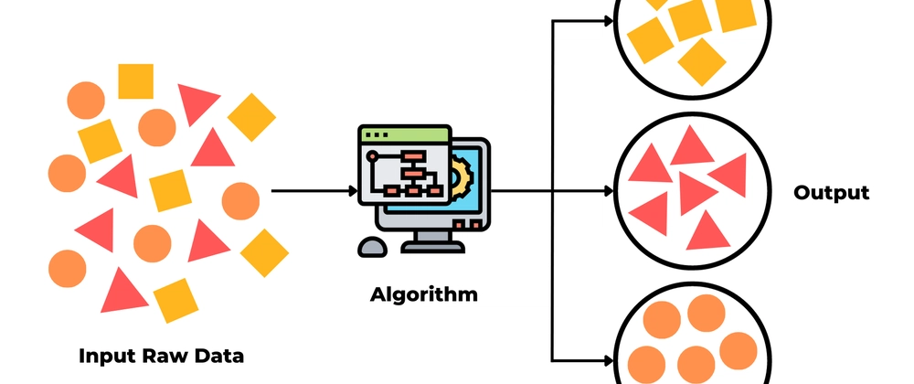
Types of Machine Learning
Supervised Learning
This method uses labelled data (input-output pairs) to predict outcomes (e.g., regression, classification).
Unsupervised Learning
This approach finds patterns in unlabelled data

Slide 8
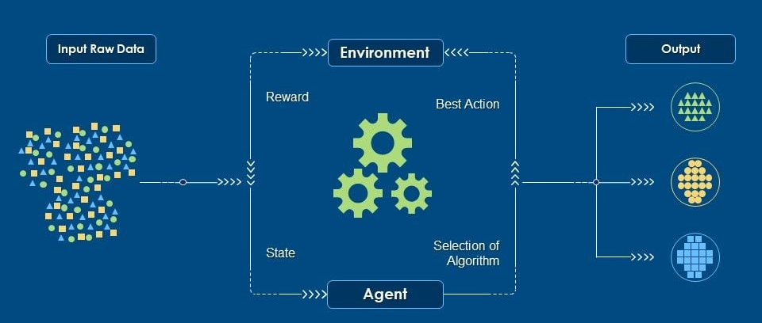
Reinforcement Learning
This ML method differs from supervised and unsupervised learning. Reinforcement learning (RL) focuses on learning by trial and error through interaction with an environment
Notes:
In reinforcement learning, An agent learns the best sequence of actions in an environment to maximize its cumulative reward
Applied in: autonomous driving vehicles, gaming and robotics

Slide 9
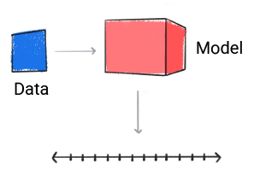
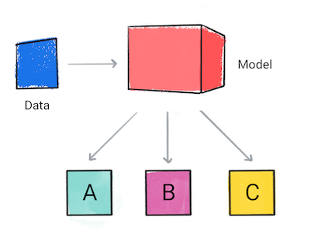
The Machine Learning Workflow
To successfully build and deploy ML models, it’s essential to follow a structured process.
This structured process is called the machine learning workflow
Step 1: Problem Definition
Clearly Define the main purpose of your ML model
Understand the type of problem being tackled: classification, regression, clustering

Slide 10

Step 2: Data Collection
Gather relevant data from various sources (databases, files, sensors, recording devices etc)
Ensure the data is a representative of the real-world scenario

Slide 11

Step 3: Data Preprocessing
Cleaning: Handle missing values, remove duplicates and correct errors
Feature Engineering: Create new features, encode categorical data
Normalise data: standardise or normalise numeric data
Splitting: Divide the data into training and testing sets (and sometimes validation sets)

Slide 12
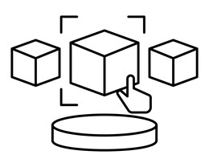

Step 4: Model Building
Model Selection
Model Training
Choose an appropriate algorithm
Consider the complexity, interpretability, and performance of the model.
Train model on the training dataset
Adjust internal parameters to reduce errors or loss

Slide 13
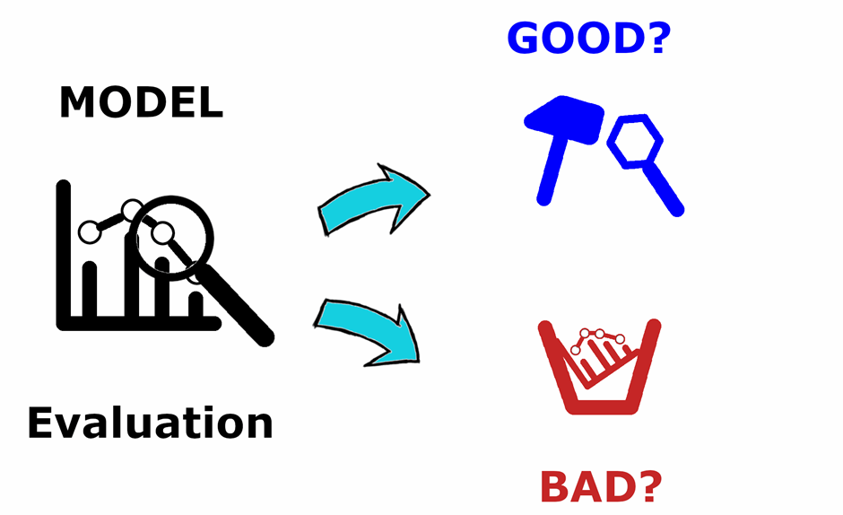
Step 5: Model Evaluation
Use metrics like accuracy, precision, recall, F1-score, or RMSE depending on the problem.
Evaluate on the testing set to assess generalization

Slide 14

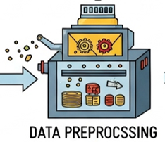



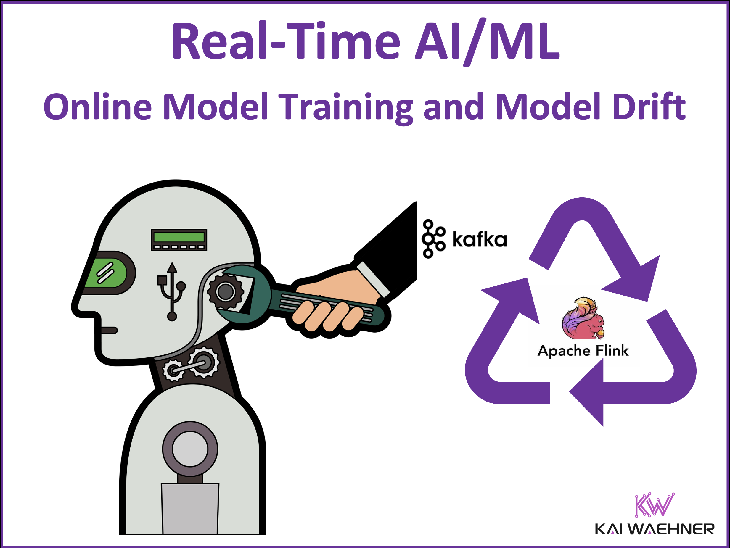
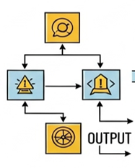

DATA COLLECTION
DATA PREPROCESSING
FEATURE EXTRACTION
MODEL DEPLOYMENT
MODEL EVALUATION
MODEL TRAINING
The ML Workflow
PREDICTION
OUTPUT

Slide 15

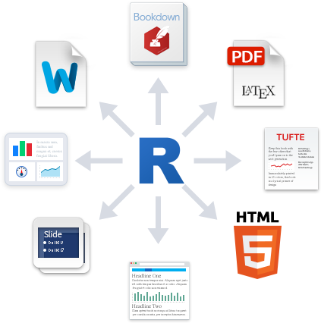



Why Use
Free and Open Source
Reproducible Research
Tools like R Markdown and its successor, Quarto, allow users to combine code, output (tables, plots), and narrative text into a single, dynamic document
No licensing costs, making it accessible to individuals, researchers, and organizations of all sizes
Rich Packages for Analysis
Active Community Worldwide
R's strength lies in its extensive collection of "packages" that extend its capabilities;
A vast and supportive global community means readily available help, tutorials, and solutions for common problems
caret, tidymodels, randomForest, ggplot2, tidyr, dplyr

Slide 16
Some Applications of ML in Environmental Monitoring
Predictive modelling for climate forecasting, species migration, and disaster prediction
Image classification for satellite data analysis and species identification
Automated anomaly detection for pollution spikes or ecosystem disruptions
Real-time processing of sensor data streams for immediate alerts
Time series analysis for trend detection in long-term environmental data
Notes:
Example: Using ML models to predict the intensity of a harmattan haze in weeks in advance, allowing for public health advisories and agricultural planning. Another example is predicting the movement of invasive species, like certain types of destructive insects/bugs, to implement targeted control measures before they spread widely in forests.
Example: Analyzing satellite images of the A region to automatically detect changes in forest cover over time, identifying areas of deforestation or illegal mining activities. Or using drone imagery and ML to identify and count specific bird species in an ecosystem
Example: Deploying sensors in a River that continuously transmit water quality data. An ML algorithm then monitors this data in real-time and automatically sends an alert if it detects unusual spikes in pollutants
Example: Installing air quality sensors in various parts of Kumasi. An ML system processes this data instantly to identify localized pollution hotspots and trigger immediate alerts to relevant authorities

Slide 17


Key Packages to Consider
Data Cleaning
The dplyr and tidyr packages are fundamental tools in the R tidyverse for efficient and expressive data manipulation and cleaning.
They promote a consistent syntax and work seamlessly together to transform messy data into a clean, tidy format suitable for analysis

Slide 18
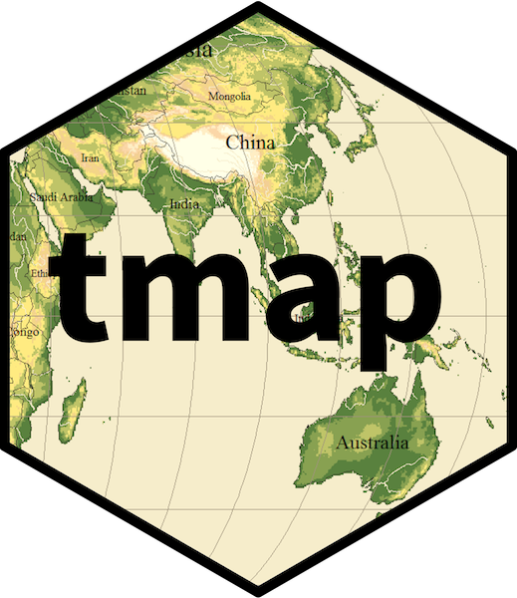
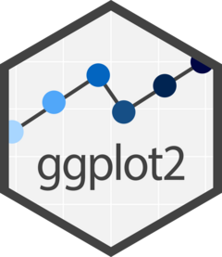

Visualisation
For your visualisations in R, ggplot2, tmap, and leaflet are your go-to packages, especially for environmental monitoring.
ggplot2, for static customisable plots
tmap, for thematic static and interactive maps
Leaflet, for full interactive web maps
Notes:
GGplot2 is ideal for visualising time series trends, comparing different sites, or showing relationships between environmental variables.
Tmap is perfect for visualising spatial patterns of environmental data like showing forest cover change over time across various regions in Ghana using colour gradients.
Leaflet is best for sharing interactive environmental monitoring data like showing the locations of monitoring stations with pop ups displaying distinct data

Slide 19


Machine Learning
caret(classification and regression training) is a well-established and comprehensive package that provides a unified interface to train and evaluate a vast number of machine learning models in R.
caret
tidymodels is a newer, modular framework that brings the principles of the tidyverse to machine learning. It's a collection of interoperable packages rather than a single monolithic one.
Notes:
Tidymodels packages include:
rsample: for splitting data
recipes: for processing data
parsnip: for fitting a particular model
tune: for hyperparameter tuning
yardstick: calculating and comparing model performance
workflow: combine recipes and parsnip into a single pipeline
dials: defining and managing tuning parameters

Slide 20


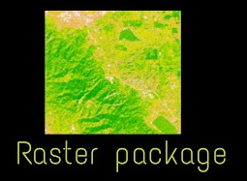
Spatial Data Analysis
The raster package was the previous standard for raster spatial data in R. While still functional, it has largely been superseded by terra
terra is the successor to the raster package, designed to be faster, more memory-efficient, and capable of handling both raster and vector data
sf is a modern and highly recommended package for working with vector spatial data (points, lines, polygons) in R.

Slide 21
PART 2:
ML Workflow Live Coding Demo

Slide 22
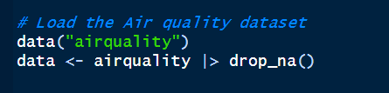
Tidymodels Workflow Code Snippet
tidymodels provides a consistent, modular, and human-readable framework for building and evaluating models, making
1.Loading and preparing data
start by importing your data from various sources (csv, excel etc)
tidymodels integrate seamlessly with tidyverse for cleaning and manipulating data

Slide 23
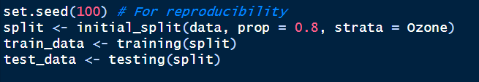
2. Data splitting
Before any modelling, the data is split into at least two subsets: training – to teach the model, testing – to estimate model performance on unseen data
Create testing dataset
Variable to conduct stratified sampling
Proportion to split for training
Create training dataset
Split data into training and testing set

Slide 24
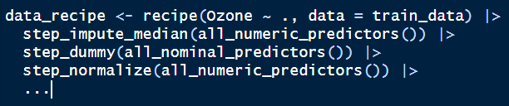
3. Feature engineering and preprocessing (recipes)
This is crucial for preparing your data for modelling using the recipes package preprocessing steps
Impute missing values
Initiate response and predictor variables for model
Standardise all numeric variables
Create dummy variables
Proportion to split for training
They define a sequence of preprocessing steps on the training data

Slide 25
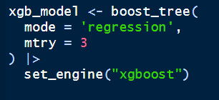
4. Model Specification (parsnip)
Declare the type of model you want to use at this stage
Specify ML model (extreme gradient boosting)
ML task to perform
Predictors proportion to randomly sample at each split
Background engine (package) to use for this model
Several ML models exist within the parsnip package for use at this stage

Slide 26
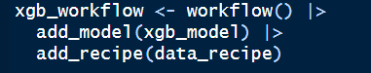
5. Creating a workflow (workflows)
Bundel together your preprocessing recipe and your model specification to create a workflow
Initiate the workflow for your ML model
Add the model specification
Add the preprocessing recipe
This ensures that the defined preprocessing steps are always applied before the model is fitted

Slide 27
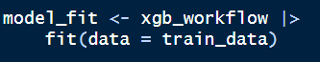
6. Model training and fitting
With the workflow defined, you "fit" the workflow to your training data
Defined workflow
Fit model to the training data
The result is a fitted model object, ready for making predictions
Additionally, you can fine tune the model by varying various hyperparameter and performing cross-validations

Slide 28
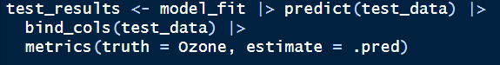
7. Model training and fitting
Once the model is tuned it is fitted again and the final fit is used for making predictions on the test data
Evaluate model performance
Compare predicted to actual
Make predictions using the fitted model
Outcome variable
Add the predicted data to the original dataset
Then, this final model makes predictions on the completely unseen testing data

Slide 29
7. Making Predictions
The ultimate goal!
The finalized, evaluated model can now be used to make predictions on truly new, never-before-seen data.

Slide 30

Live Code Demonstration
Goal:
Predict rainfall in Ghana using environmental data.
Scan this code to access dataset
Steps:
2. Train a regression model using caret or tidymodels.
1. Load synthetic environmental data (rainfall, temperature, humidity).
3. Visualize predictions with ggplot2.

Slide 31
RESOURCES
Nowosad, M. T. and J. (2025, June 17). Elegant and informative maps with tmap. https://tmap.geocompx.org/
Welcome | Geocomputation with R. (n.d.). Retrieved 17 June 2025, from https://r.geocompx.org/
Welcome! – Tidymodels. (n.d.). Retrieved 17 June 2025, from https://www.tidymodels.org/start/

